Slide 1
Node Package Manager
Node Package Manager (NPM) is a command line tool that installs, updates or uninstalls Node.js packages in your application.
It is also an online repository for open-source Node.js packages.
The node community around the world creates useful modules and publishes them as packages in this repository.

Slide 2
Node Package Manager
NPM is included with Node.js installation. After you install Node.js, verify NPM installation by writing the following command in terminal or command prompt
npm -v

Slide 3
Install package locally
Use the following command to install any third party module in your local Node.js project folder.
npm install <package name>
npm install prompt-sync

Slide 4
Install package locally
Use the following command to install any third party module in your local Node.js project folder.
C:\>npm install <package name>
C:\Project> npm install prompt-sync

Slide 5
Install package globally
NPM can also install packages globally so that all the node.js application on that computer can import and use the installed packages.
NPM installs global packages into node_modules folder.
C:\Project> npm install -g prompt-sync

Slide 6
Update package
To update the package installed locally in your Node.js project, navigate the command prompt or terminal window path to the project folder and write the following update command.
C:\Project> npm update <package name>

Slide 7
Unistall packages
Use the following command to remove a local package from your project.
C:\>npm uninstall <package name>
The following command will uninstall ExpressJS from the application.
C:\Project> npm uninstall prompt-sync

Slide 8
Installation
Repl
github

Slide 9
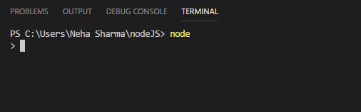
REPL- Virtual Environment
REPL stands for Read-Eval-Print-Loop.
You can now test pretty much any Node.js/JavaScript expression in REPL.

Slide 10
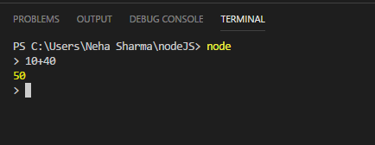
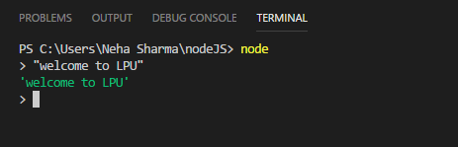

Slide 11
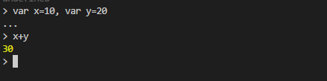
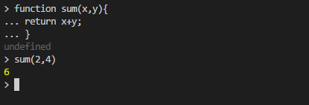
Defining variables
Multi-line javascript expression

Slide 12

Include external javaScript file
Node filename command can be used
Use _ to check the last stored value.
Tab key

Slide 13
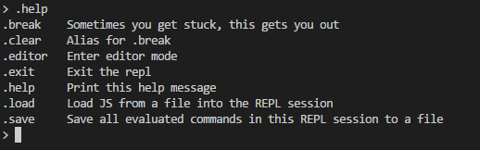
.help
Tab keys

